Slide 1
Database Systems
Lecture 6
The Database System Environment

Slide 2
Today’s agenda
The Database System Environment
DBMS Component Modules
Database System Utilities
Application Environments
Communications Facilities

Slide 3
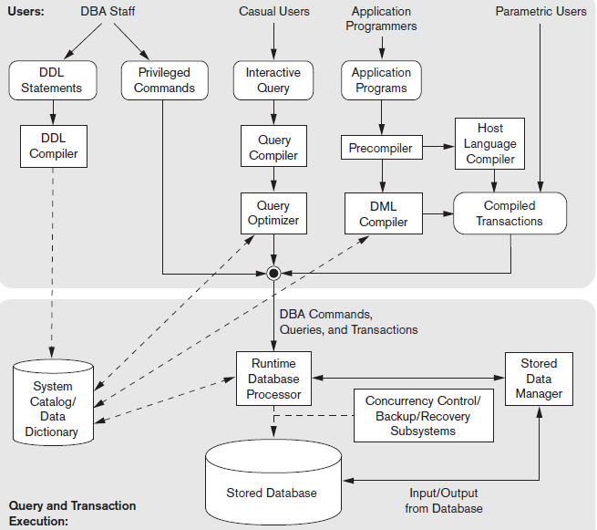
Component of a DBMS

Slide 4
DBMS Component Modules
Top half of figure refers to various users of the database environment and their interfaces, while the lower half shows the internals of the DBMS responsible for data storage and transaction processing.
A higher-level stored data manager module of the DBMS controls access to DBMS information that is stored on the disk, whether it is part of the database or the catalog.
The DDL compiler processes schema definitions specified in the DDL, and stores descriptions of the schemas (meta-data) in the DBMS catalog.
The catalog includes information such as names and sizes of files, names and data-types of data items, storage details, mapping information among schemas, constraints and so on
DBMS software module then look up the catalog information as needed.

Slide 5
DBMS Component Modules
The query compiler handles high-level queries that are entered interactively. (parses and analyzes a query).
Query optimizer is concerned with rearrangement and possible reordering of operations, elimination of redundancies and use of correct algorithm and indexes
The pre-compiler extracts DML commands from an application program written in a host programming language. These commands are sent to the DML compiler for compilation into object code for database access.
Rest of the program is sent to host language compiler.

Slide 6
DBMS Component Modules
The run-time database processor handles database accesses at run time; it receives retrieval or updated operations and carries them out on the database.

Slide 7
DBMS Component Modules
It is now common to have the client program that accesses the DBMS running on a separate computer from the computer on which the database resides. The former is called the client computer, and the latter is called the database server. In some cases, the client accesses a middle computer, called the application server, which in turn accesses the database server.

Slide 8
Database System Utilities
To perform certain functions such as:
Loading It is used to load existing files into a database. Includes data conversion tools.
Backing up the database periodically on tape.
Database storage reorganization.
Report generation utilities.
Performance monitoring utilities.
Other functions, such as sorting, user access monitoring, data compression, etc.

Slide 9
Other Tools
Data dictionary / repository:
Other tools are often available to database designers, users and DBMS such as CASE tools are used in the design phase of database systems.
Another tool that can be quite useful in large organizations is an expanded data dictionary/repository.
In addition to storing catalog information about schemas and constraints, it stores other information such as design decisions, application program descriptions, user information, usage standards, etc. (also called information repository)

Slide 10
Applications Development Environments
Examples – Power builder (Sybase), JBuilder (Borland)
These systems provide an environment for developing database applications and include facilities that help in many facets of database systems, including
Database design,
GUI development,
Querying and updating, and
Application program development

Slide 11
Communications Facilities
Its function is to allow users at locations remote from the database system site to access the database through computer terminals, workstations, or their local personal computers.
Many commercial database systems have communication packages that work with the DBMS. The integrated DBMS and Data Communication system is called a DB/DC system.

